Slide 1

TOK
Presentation

Slide 2
Real life situation The Story of the Andes Survivors

Slide 3
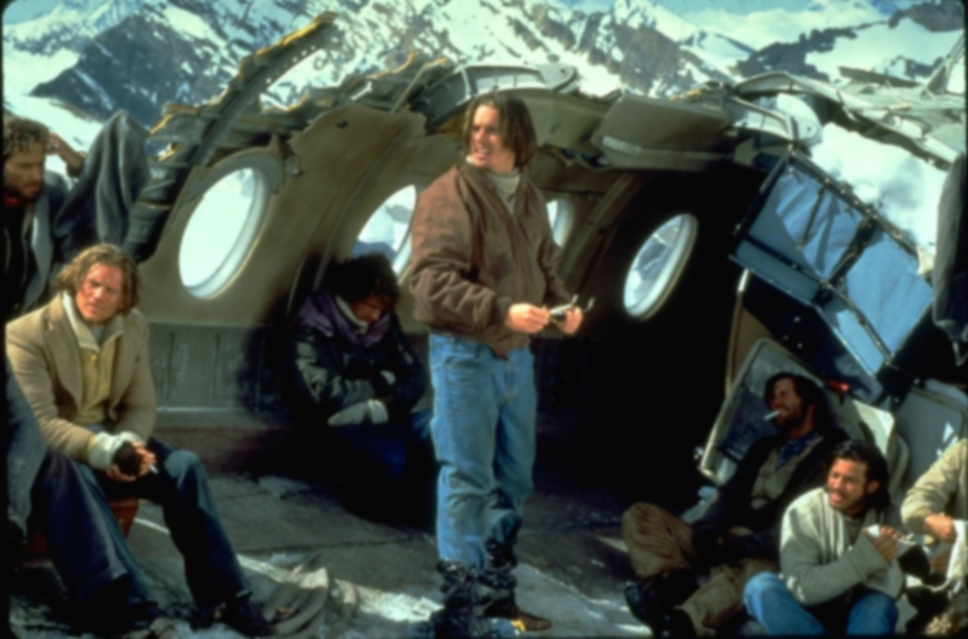
Real life situation The Story of the Andes Survivors
Knowledge Question
Notes:
also known as the Andes flight disaster and, in South America, as the Miracle of the Andes (El Milagro de los Andes) was a chartered flight carrying 45 people, including a American football union team, their friends, family and associates, that crashed in the Andes on 13th October 1972. More than a quarter of the passengers died in the crash and several others quickly suffered from cold and injury. Of the 27 who were alive a few days after the accident, another eight were killed by an avalanche. The last 16 survivors were rescued more than two months after the crash.
Here you may have a question how can 16 people survive over two month in the center of mountain.
They had little food and no source of heat in the harsh conditions at over 3,600 metres (11,800 ft) altitude. Faced with starvation and radio news reports that the search for them had been abandoned, the survivors fed on the dead passengers who had been preserved in the snow. Rescuers did not learn of the survivors until 72 days after the crash when two passengers, after a 10-day wade across the Andes, found a local man there,[1] who gave them food and then alerted the existence of the other survivors.
Cannibalism: the practice of eating the flesh of your own kind.

Slide 4
To what extent could cannibalism be morally reasonable in specific situations?
Notes:
Cannibalism: the practice of eating the flesh of your own kind.

Slide 5
Claim I
Cannibalism is reasonable
to meet humans’ basic needs
Notes:
Humanbeings have to face cannibalism in some extreme circumstance.
Great Famine
There are several serious famines in humun history.
Examples
Definition:
Maslow subsequently extended the idea to include his observations of humans' innate curiosity. His theories parallel many other theories of human developmental psychology, some of which focus on describing the stages of growth in humans.
According to Maslow’s hirechey of needs, physiological needs are the most fundamental needs. They are physical requirements for human survial. Physiological needs are thought to be the most important; in other words they should be met first. Otherwise people are not able to achieve any needs upon it. In that case, ethical is more like some contained in “love and belonging” part. Just like what I mention before, for achieving this part. You have to meet this part successfully.
In an extreme condition that without any food resource; it is understandable to survive by eatiing dead body of human beings.

Slide 6
Self-
Actualization
Esteem
Belonging
Physiological
Safety
Maslow's hierarchy of needs
Notes:
Humanbeings have to face cannibalism in some extreme circumstance.
Great Famine
There are several serious famines in humun history.
Examples
Definition:
Maslow subsequently extended the idea to include his observations of humans' innate curiosity. His theories parallel many other theories of human developmental psychology, some of which focus on describing the stages of growth in humans.
According to Maslow’s hirechey of needs, physiological needs are the most fundamental needs. They are physical requirements for human survial. Physiological needs are thought to be the most important; in other words they should be met first. Otherwise people are not able to achieve any needs upon it. In that case, ethical is more like some contained in “love and belonging” part. Just like what I mention before, for achieving this part. You have to meet this part successfully.
In an extreme condition that without any food resource; it is understandable to survive by eatiing dead body of human beings.

Slide 7
Counterclaim I
Cannibalism itself is not ethical
though it is compelled
Notes:
Counterclaim:
Although they survive from the accident, they will suffer form guilty in their following lifes.
Cannibalism or Intraspecific prey is special but common phenomenon in animal kingdom, especially those invertebrate creations. Among vertebrate animals, some fish or forgs have cannibal behavior when they meet problem such as scarcity of food.
On account of recent research on vertabrate animals, there are at least 14 mammals that have cannibalism.
However we are superior creation than animals we known in earth.
We develop a complete system about ethics and morality.
We have much more complex emotion than animals.
Cannibalism is not going ot be morally reasonable in this case.

Slide 8
Claim II
Cannibalism is acceptable since it exists in a independent culture as well as a religion
Notes:
As everyone knows, there are something else than basic physiologic demand that causes the cannibalism. To a big part it is about the culture, including derived beliefs and influenced emotion, and they are a large part of motivation of cannibalism in ancient or primitive society. Anthropologist Peggy Reeves Sanday found evidence for cannibalism in 34% of cultures in one cross-historical sample.

Slide 9
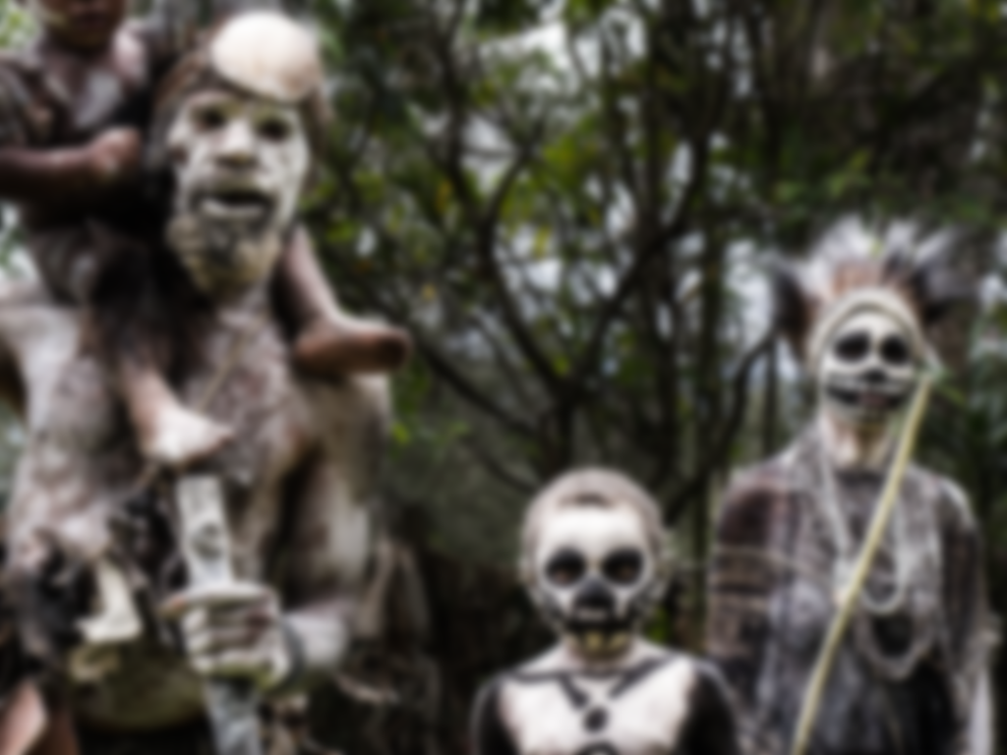
Claim II
Among certain South American and African tribes, for example, the bodies of killed foes were cooked and eaten, or burned, reduced to powder, and put in drinks.
Notes:
Among certain South American and African tribes, for example, the bodies of killed foes were cooked and eaten, or burned, reduced to powder, and put in drinks. This was said to protect the victors against attacks by the souls of the deceased, and also to be a way of acquiring their energy. Other tribesmen have disapproved of the practice but claimed it is done by witches and sorcerers in order to gain magical power. In still other societies, such as some in New Guinea, parts of the bodies of relatives, who had died naturally, were eaten as a benign way of expressing kinship and assuring their REINCARNATION within the tribe.

Slide 10

Claim II
Among the Aztecs of Mexico reports have alleged that the bodies of the victims whose hearts and blood were regularly offered to nourish the sun were then eaten
by priests and nobility.
Notes:
Cannibalism has also sometimes been a part of religious sacrifice. In Fiji the communal eating of cannibal victims who had been sacrificed to a major god was said to be a way of cementing 粘合 an alliance between chiefs. Among the Aztecs of Mexico, reports have al‘leged that the bodies of the victims whose hearts and blood were regularly offered to nourish the sun were then eaten by priests and nobility. To eat offerings presented to the gods is widely considered a means of having communion with that god and with other worshippers.

Slide 11
Claim II
Cannibalism is acceptable since it exists in a independent culture as well as a religion
Notes:
From the perspective of moral relativism, the concept of ethics could only be applied within specific cultural boundaries where this moral system originated. And thus, the cannibalism could not be condemned as an immoral behavior which violates the human nature. In fact, interfering those cannibalisms in these cultures is even not justified by the standard which claims to respect other cultures.

Slide 12
Counterclaim II
Cultural independence does not
justify the cannibalism
Back to Knowledge Question
Notes:
If some cultures have religions really have motivated people to be cannibal, the moral relativism could not truly justify the cannibalism. I believe that ethical relativism is only a worthy belief if cultures were never to overlap. Sometimes we say that we cannot judge another culture because we cannot fully understand them, but if we begin to understand them does it give us the right to judge them. And in a modern society, these cannibal behaviors are incompatible with the universal principle of morality.
A cultural independence may become an excuse to maintain the cannibalism, but after the great globalization, these regions have become exposed to the majority. Their backward cannibalistic idea, just like the foot binding in China or improper corseting in Europe, is supposed to be abandoned as they are detrimental to humans within the culture. Therefore, cannibalism is not moralized by its role as a feature of a culture.

Slide 13
To what extent could cannibalism be morally reasonable in specific situations?
Notes:
Turn back to knowledge question
To answer Now we have a proper resolution

Slide 14
Resolution
Cannibalism is only reasonable
in the situation of extreme dearth of food
and within the specific cultural boundary
Notes:
Our resolution is that cannibalism is only reasonable in the situation of extreme dearth of food and within the specific cultural boundary.

Slide 15
Recapitulation
In The Story of the Andes Survivors,
cannibalism is excusable
Notes:
When we recapitulate the real life situation, we could find

Slide 16
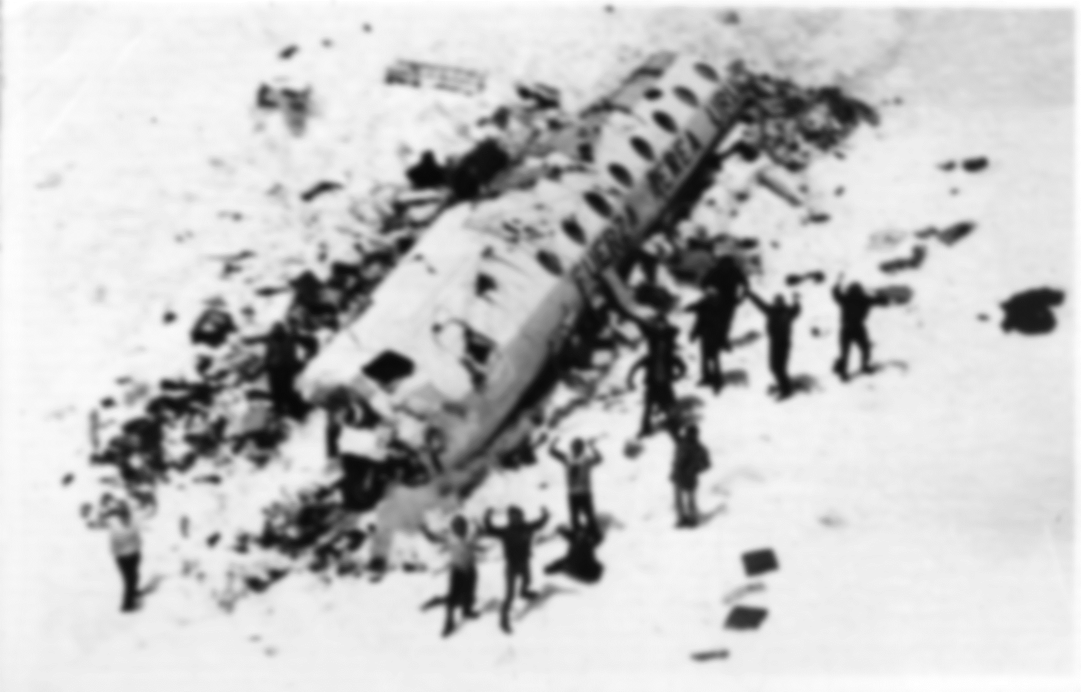
Recapitulation
In The Story of the Andes Survivors,
cannibalism is excusable
Notes:
In the story of the Andes survivors, these people do not really have any other choices. If Eat and they can be alive, refuse and they have to die. The public does not have any rights to condemn their compelled cannibalism. It is the same to some cannibal instances of famine in the history.

Slide 17
Applied in other RLS
In primitive tribes,
cannibalism is justified by their own cultures
Notes:
In primitive tribes, no matter African tribes or Aztecs their cannibalism is only allowed in their specific tribes. A culture has its right to maintain its tradition and independence. From the perspective of moral universalism, an interference is also problematic. If You take action to eliminate the cannibalism or arrest those cannibals, your action also violate other culture’s right to have complete tradition. Only people belong to the culture know what cannibalism really means to them. Initiative or spontaneous awareness of drawbacks of cannibalism is more favorable to give them a better living condition.

Slide 18
Applied in other RLS
Armin Meiwes’ cannibalism is completely not acceptable
since his behavior violates the moral standards in Germany
Notes:
For people who has freaky mind or have insanity, things are not the same. There is a example. Meiwes posted an advertisement on the website to find volunteers to eat. Many other people responded to the advertisement, but backed out. Still, one engineer is willing to become Meiwes’ victim and then he was eaten by Meiwes. In civilized society, this behavior or this special hobby could really violate both legislation and moral code. Will it be morally reasonable ? The answer is apparent not.

Slide 19
Conclusion
Cannibalism should be forgiven within the extreme condition
Yet cannibalism is better to be the last choice to survive
Interference is not justified when it is applied to an independent culture
But cannibalism should not happen
violating the law within modern society
Notes:
Cannibalism should be forgiven within the extreme condition like the Andes survivors yet cannibalism is better to be the last choice to survive
We are not cannibals, so we cannot really know how they accept it. Maybe they are also afraid of being victims of their own cannibalism. We never know why these people volunteered to be eaten by people like Armin Meiwes. Perhaps for freaky mind or abnormal preference. I believe cannibalism has ever existed and now is still existing. But it would be impossible to offer an absolutely correct judgment to cannibalism.

Slide 20
END
Notes:
We are not cannibals, so we cannot really know how they accept it. Maybe they are also afraid of being victims of their own cannibalism. We never know why these people volunteered to be eaten by Armin Meiwes. Perhaps for freaky mind or abnormal preference. I believe cannibalism has ever existed and now is still existing. But it would be better for us to leave it along.

Slide 23
Bibliography
Morality is a Culturally Conditioned Response
http://www.macalester.edu/academics/psychology/whathap/ubnrp/aesthetics/perception.html
Morality: Nature or Culture?
http://www.forbes.com/sites/willwilkinson/2011/03/28/morality-nature-or-culture/
Ethical Relativism And Cannibalism
http://www.reviewessays.com/print/Ethical-Relativism-Cannibalism/21338.html
The Story of Andes Survivors
http://en.wikipedia.org/wiki/Uruguayan_Air_Force_Flight_571

